Slide 1


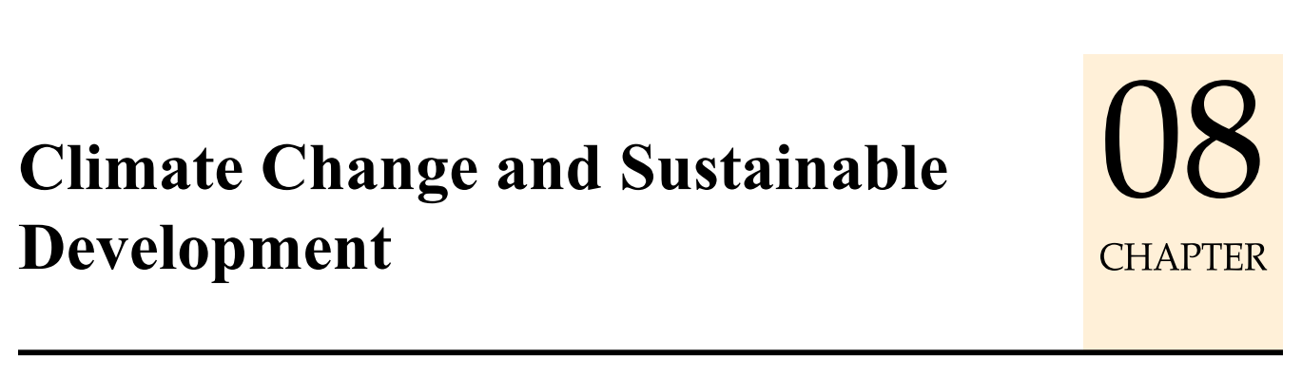
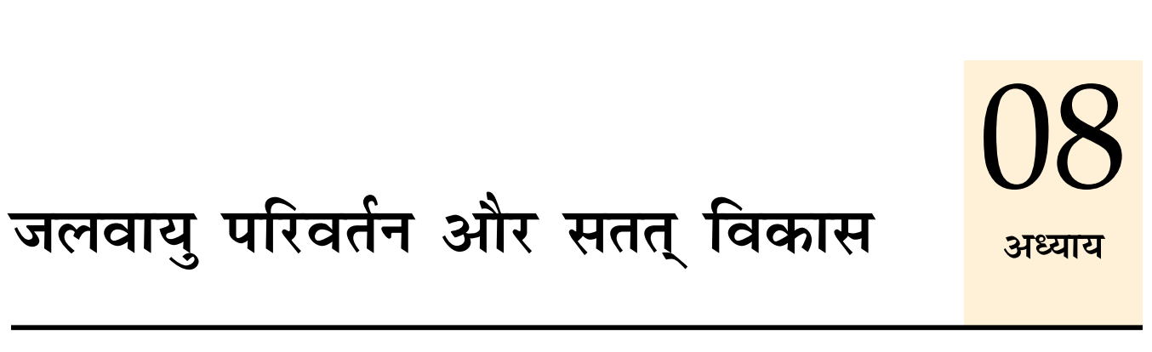
Theory +Economic Survey Vol.2 + Vol.1 + Budget 2016
1.Banking Finance
6.HRD
2.Budget-Fiscal Policy
3.BoP
4.Sectors of Economy
5.Infra & environment
V2C2-Pub.Fin; V1C3-JAM
V2C3-Monetary mgmt+FI
V2C4-External sector
V2C5-Price,Agri.; V2C6,7
V2C8-Paris Summit, Energy
V2C9-Social infra.
V1C4-Agri ; V1C9-Fertilizer
V1C5-mother-child
V1C6-bounties; V1C7-Fiscal Cap
V1C8-PTA
V1C2-Chakravy; V1C10-Labour
V1C11-Powering 1 India
B1. Financial Sector Reforms
B2. Fiscal Discipline
B3. Tax Reforms; B4. Ease of
B5. Agro: 2x farmer income
B6. Rural infra-employment
B7. Infrastructure
B8. Social Sector & healthcare
B9. Education, Skills, Jobs
V2C1- Chakravyuh challenge
V1C1- Twin Balancesheet
IYB:7-Commerce

Slide 2
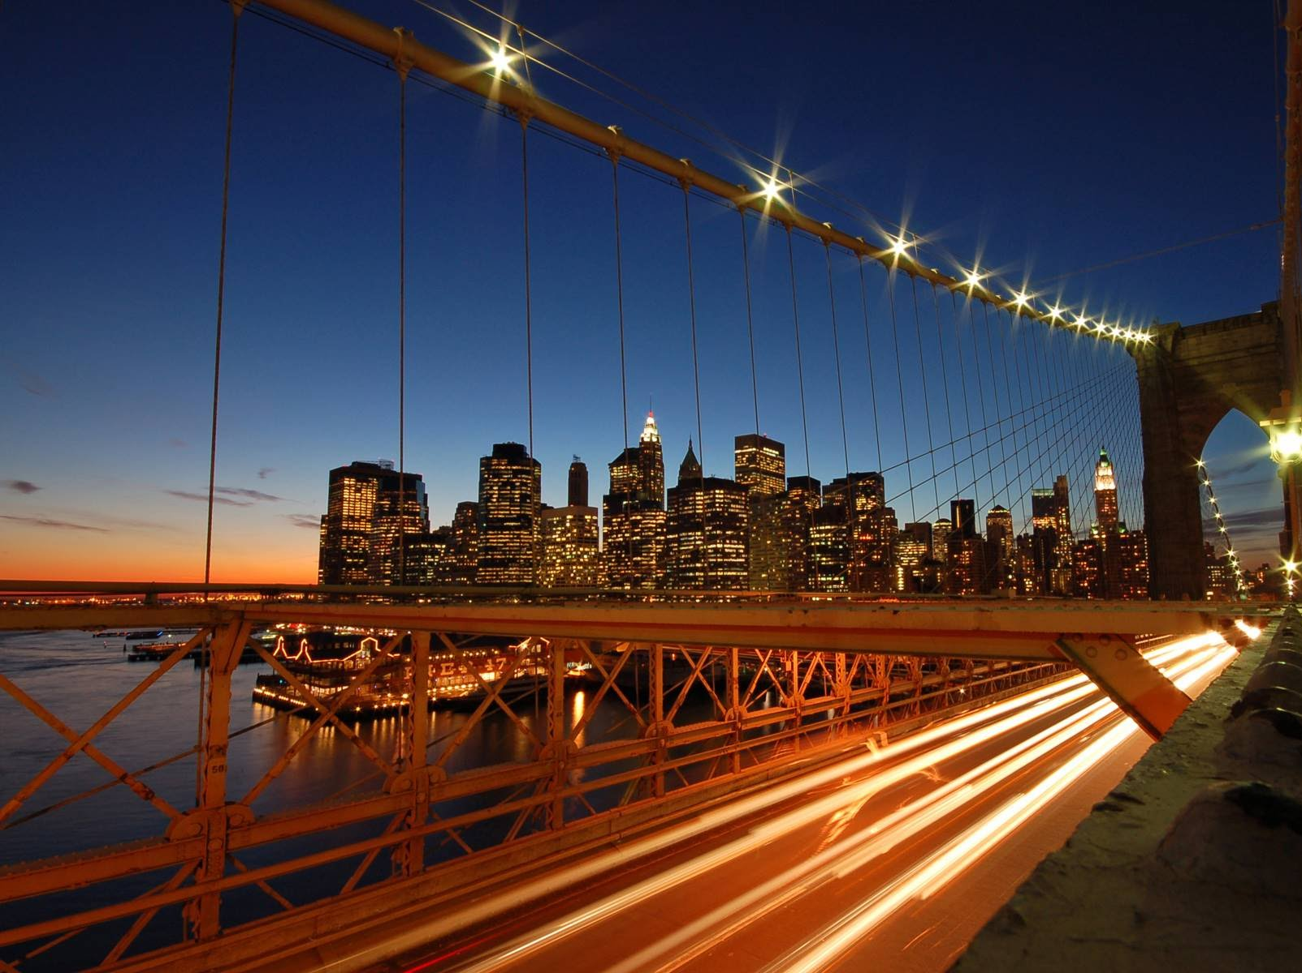
BES165: Infrastructure
Nuke Energy NSG, HELP-2016
Postal, Telecom, Mass.Comm (YB)
Kelkar-PPP
Rail Budget CAP-2016
Urban Infra-Bills.
Paris Summit Clean Energy

Slide 3


BES165► PARIS SUMMIT 2015 & Clean Energy
Pre-industrial level
CBDR, Kuznet
INDC
Funding
Implement When?
Clean Energy-India

Slide 4
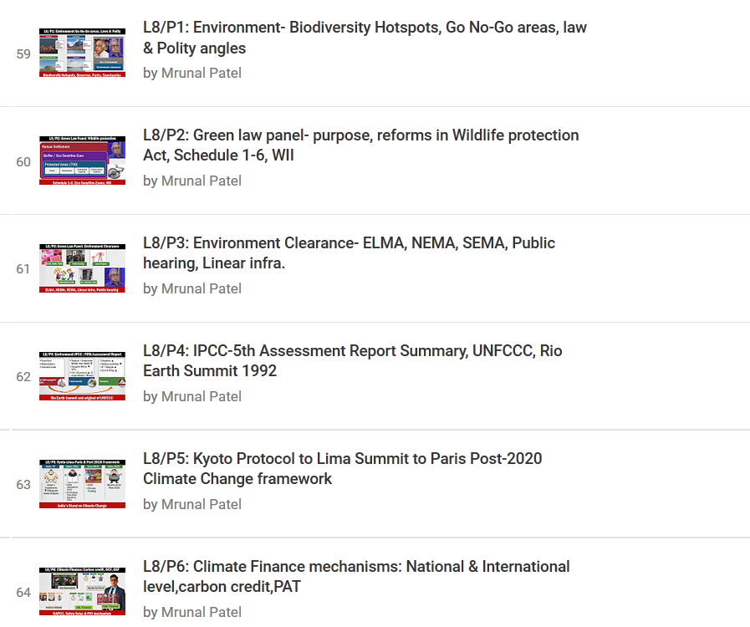

Low Priority

Slide 5
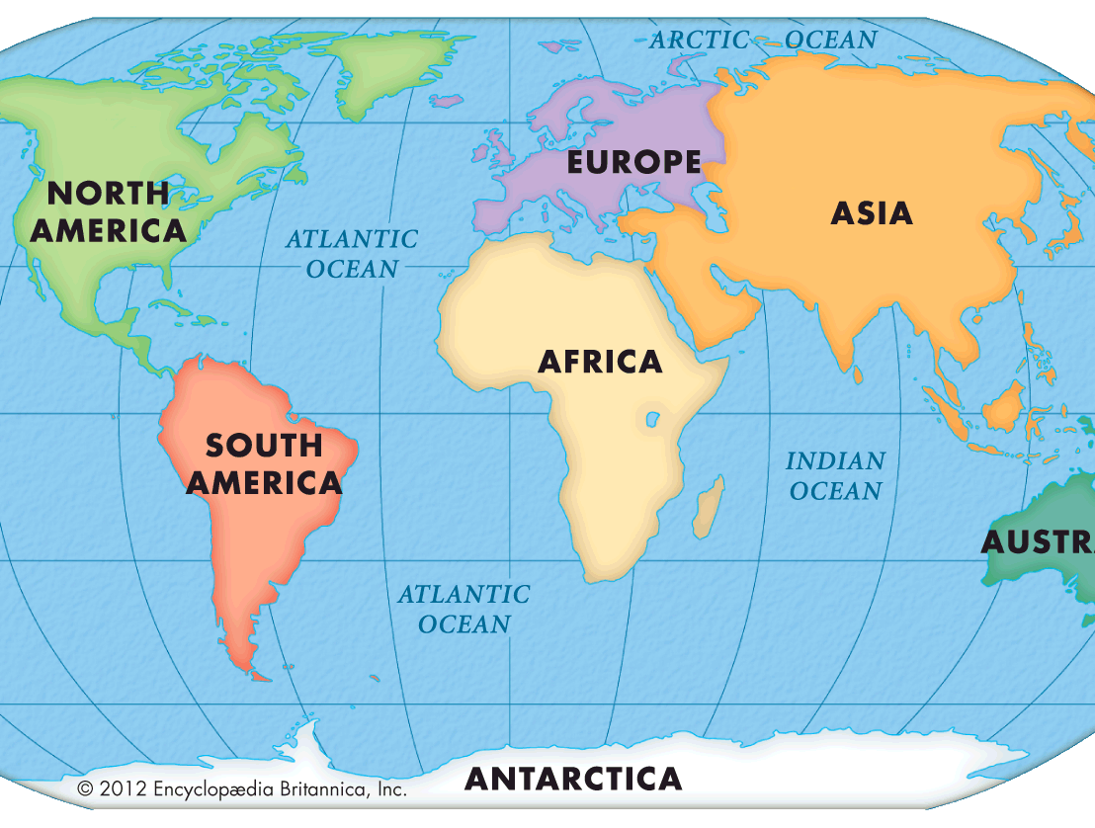
2015: Two important events
2015-Dec: UNFCCC Paris
COP-21, 195 Members
29 articles, 139 decisions
2000: UNGA, NY. MDG, 15 years
2015- Sep: UNGA, NY. SDG: 17 goals, 169 targets, More in “BES166”
Notes:
SDG and Paris summit

Slide 6
Roadmap for Climate Change (UNFCCC)
Kyoto ‘97
Annex 1 Countries to ▼GHG as per Annex-B Quota
Qatar, 2012
Kyoto extended till 2020
Paris, 2015
What to do for Post-2020
But Post-2020 Agenda be developed by 2015.

Slide 7
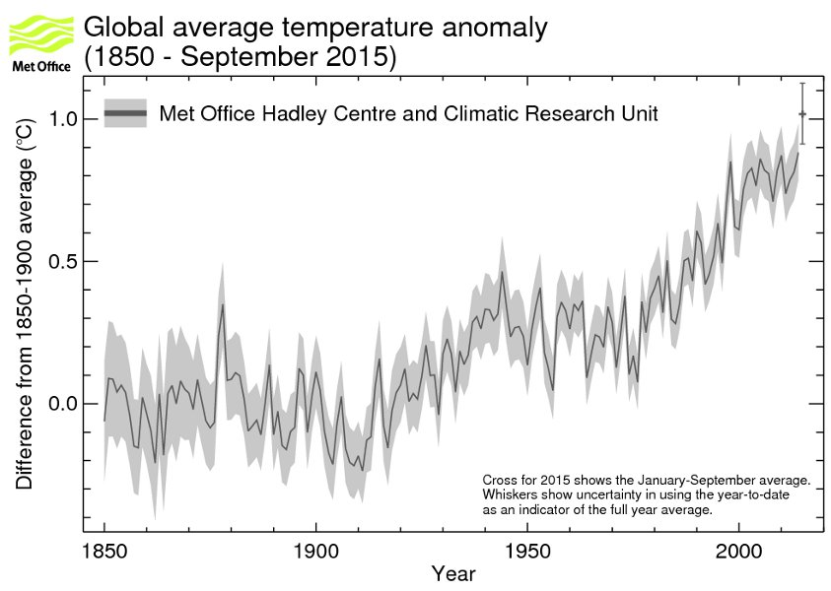
What is Pre-industrial level ka 2 Degree?
2015: 1.02 above pre industrial
Warmest year, WMO
El Nino also blamed
+1.02
+0.5
0
IPCC- pre-industrial
1850-1900
2015
Before that, reliable data not available
Notes:
http://www.metoffice.gov.uk/research/news/2015/global-average-temperature-2015

Slide 8

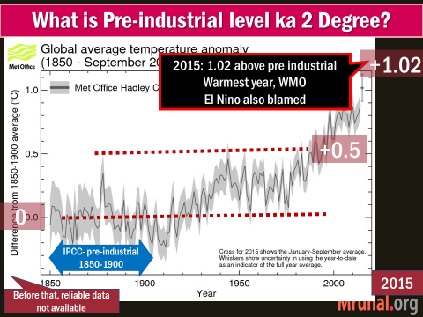
Keep within 2 C
If possible within 1.5 C
>2 Degree
1.5 Degree

Slide 9
BES165► PARIS SUMMIT 2015 & Clean Energy
Pre-industrial level
CBDR, Kuznet
INDC
Funding
Implement When?
Clean Energy-India

Slide 10

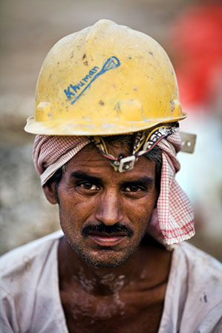
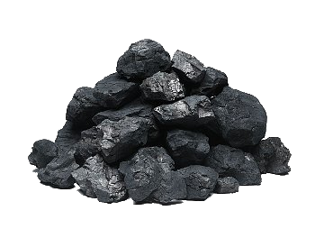
Ranking: India-Sources of CO₂ Emission

Slide 11
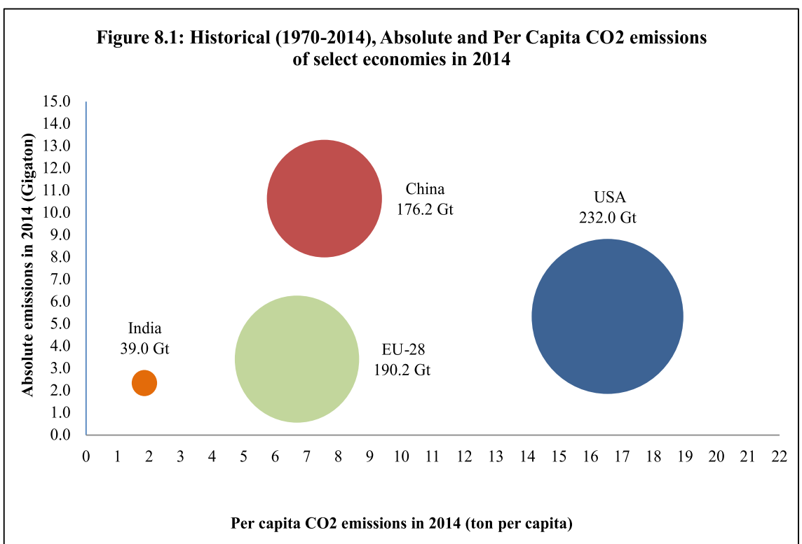
RANKING- absolute emission

Slide 12
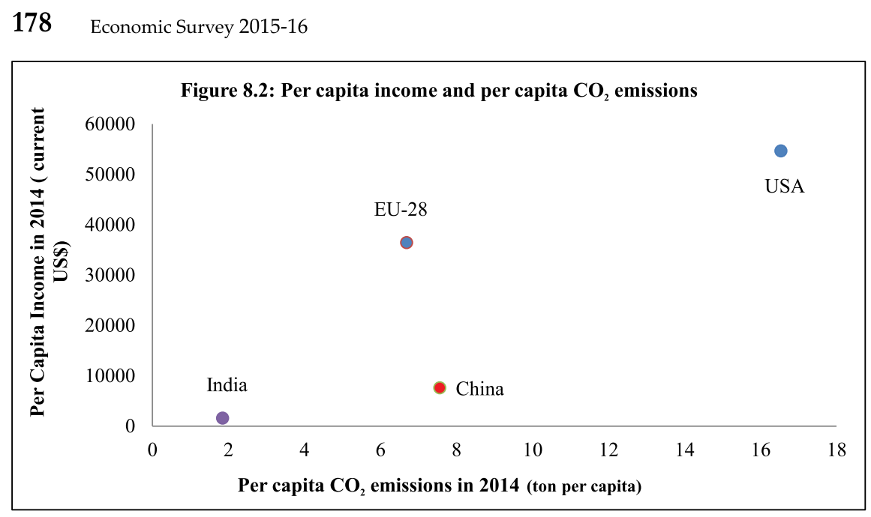
RANKING: Per capita emission

Slide 13
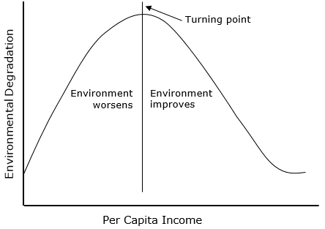
Agri 2 indu.
Low-technology
Urbanization
Indus 2 services
Resource scarcity: govt, citizens become conscious
Envi. Kuznets Curve- inverted “U”: TheHindu, 2012 LINK

Slide 14
UPSC CDS-2015-2
Pollution trends follow an inverse-U shaped relationship across different stages of economic development.
In the beginning stage, pollution increases due to urbanization & industrialization.
In the later stage, pollution declines due to structural changes towards services sector.

Slide 15


Paris Summit: CBDR reaffirmed
Right to develop
Protect vulnerable
Peaking Emission
3rd world will take longer time
ToT, R&D, Innovation
1st world ► 3rd World
Finance
1st world to take lead
Notes:
The Agreement provides binding obligation for developed countries to provide financial resources to developing countries for both mitigation and adaptation while encouraging other countries to provide support on voluntary basis. It reaffirms that developed countries will take the lead in mobilizing climate finance from a wide variety of sources, instruments and channels, noting the significant role of public funds.
development imperatives of developing countries by recognizing their right to development and their efforts to harmonize it with the environment, while protecting the interests of the most vulnerable.
CBDR-RC has been maintained across all the important pillars of the agreement (mitigation, adaptation, finance, technology development and transfer, capacity building and transparency of action and support).
The Paris Agreement operationalizes differentiation between developed and developing countries mitigation actions through three main elements, namely,
(a) by acknowledging that peaking of emission in developing countries will take longer;
(b) by calling upon developed countries to take the lead in mitigation actions;
(c) by calling upon support to be provided to developing countries for implementation of climate change actions,

Slide 16

Paris Summit: $$
Voluntary for us!
1st world: $100 bn by 2020
Adaption + Mitigation
Notes:
The Agreement provides binding obligation for developed countries to provide financial resources to developing countries for both mitigation and adaptation while encouraging other countries to provide support on voluntary basis. It reaffirms that developed countries will take the lead in mobilizing climate finance from a wide variety of sources, instruments and channels, noting the significant role of public funds.
development imperatives of developing countries by recognizing their right to development and their efforts to harmonize it with the environment, while protecting the interests of the most vulnerable.
mandates that developed countries provide financial resources to developing countries. Other Parties may also contribute, but on a purely voluntary basis.

Slide 17
PARIS SUMMIT 2015
Pre-industrial level
CBDR, Kuznet
INDC
Funding
Implement When?
Clean Energy-India

Slide 18

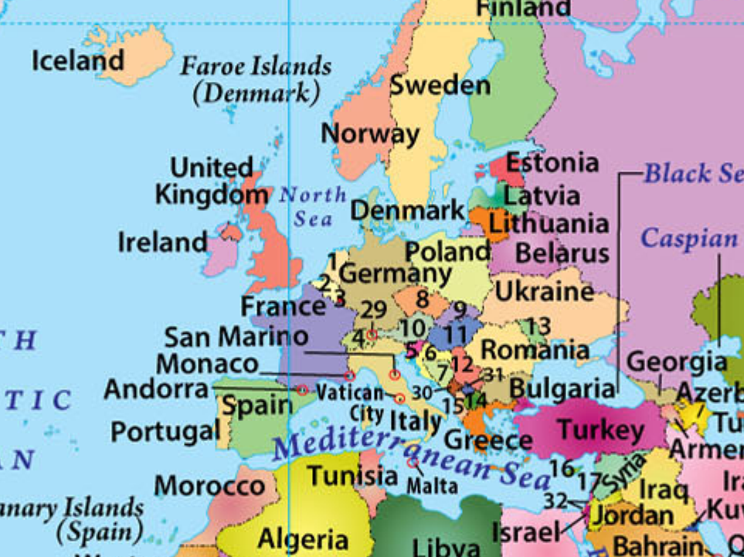

Intended Nationally Determined Contribution (INDC)
2013: WARSAW summit, all countries requested to prepare INDC.
India submitted
on 2nd Oct 2015.
Total 119 submitted

Slide 19
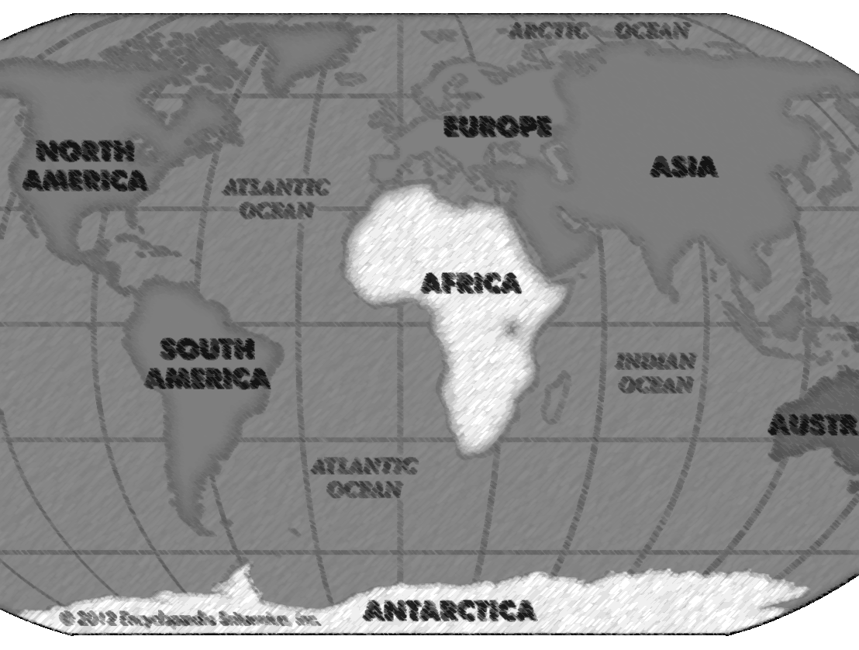


Paris Summit: Commitment & Review
Each successive INDC should be higher than before
Submit 1st INDC by 2020
Thereafter, each 5 years
+ give Biennial updates
From 2023
5-yearly reviews
“non-punitive” way
Notes:
NDCs may also include quantifiable information, time frames for implementation, scope and coverage, planning processes, assumptions and methodological approaches, including those for estimating and accounting for anthropogenic greenhouse gases.
The Agreement provides binding obligation for developed countries to provide financial resources to developing countries for both mitigation and adaptation while encouraging other countries to provide support on voluntary basis. It reaffirms that developed countries will take the lead in mobilizing climate finance from a wide variety of sources, instruments and channels, noting the significant role of public funds.
development imperatives of developing countries by recognizing their right to development and their efforts to harmonize it with the environment, while protecting the interests of the most vulnerable.
mandates that developed countries provide financial resources to developing countries. Other Parties may also contribute, but on a purely voluntary basis.
Agreement seeks to enhance the ‘implementation of the Convention’ while reflecting the principles of equity and CBDR-RC, in the light of different national circumstances.
Countries are required to communicate to the UNFCCC climate action plans known as nationally determined contributions (NDCs) every five year
. Each Party’s successive NDC will represent a progression beyond the Party’s then current NDC thereby steadily increasing global effort and ambition in the long term.
Climate action will also be taken forward in the period before 2020.
s a compliance mechanism, overseen by a committee of experts that operates in a non-punitive way, and is facilitative in nature.
Starting in 2023, a global stocktake covering all elements will take place every five years to assess the collective progress towards achieving the purpose of the Paris Agreement and its long term goals.
NDCs:
Paris Agreement invites Parties to submit their first nationally determined contributions prior to the submission of their instruments of ratification, accession, or approval of the Agreement.
this requirement stands satisfied if a Party has already communicated its INDC prior to joining the Agreement.
The Parties whose intended nationally determined contributions have a time frame up to 2025- 2030 are required to communicate or update these contributions by 2020 and to do so every five years thereafter.
Each Party’s successive nationally determined contribution will represent a progression beyond the Party’s then current nationally determined contribution.
8.20 Global stocktake:
s a framework for global stocktake to assess the collective action towards achieving the long-term goals mentioned in the Agreement
This stocktake would be an assessment of the aggregate level of ambition communicated through the NDCs in relation to the level needed, while considering mitigation, adaptation and the means of implementation and support, and in the light of equity. The first stocktake is slated for 2023.
(October 2015) of the UNFCCC, states that 119 INDCs were communicated by 147 Parties representing 86 per cent of global greenhouse gas emissions in 2010. Out of the 119 INDCs submitted, 100 had an adaptation component,
The INDCs of most countries are national in scope and can be implemented through their national action plan (NAP) and they cover a large number of sectors. In addition to adaptation, some of the
INDCs also have quantified loss and damage projections.

Slide 20


CRITICISM
PARIS Summit
INDC “MAY” include quantifiable targets, timeframe.
REVIEW in “NON-PUNITIVE” manner

Slide 21
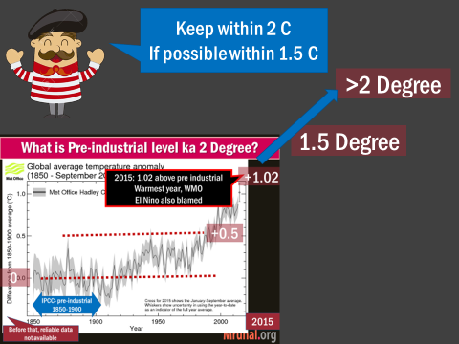
CRITICISM
PARIS Summit
To keep Global warming within 2 Degree limit: Need to cut CO₂ by 55 Giga Tonnes
But INDCs so far ~40 GT

Slide 22

review of Biennial updates Report (BR)
1st world
international assessment and review (IAR)
3rd world
international consultation and analysis (ICA).
साला इतना डिटेल में कोन तैयार करता है?
Notes:
The information provided by the developed countries in their National Communications, Biennial Reports (BR), etc. is subject to while that provided by developing countries in their National Communications and Biennial Update Reports (BUR) is subject to
However, the review process
will give due consideration to the respective national capabilities and circumstances of developing countries.
Countries will be required to report on their anthropogenic emissions by sources and removals by sinks of greenhouse gases, and regularly track progress on achieving their NDCs.

Slide 23
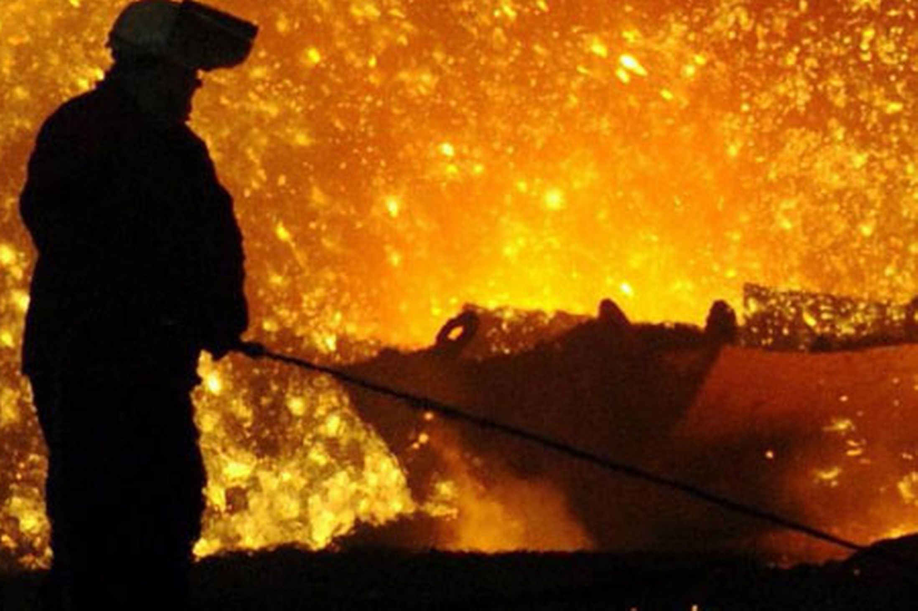
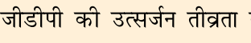
India’s INDC: Kasam #1
33-35% reduction
Notes:
set itself an ambitious target of reducing its emissions intensity of its gross domestic product (GDP) by 33-35 per cent by 2030, compared to 2005 levels, and of

Slide 24
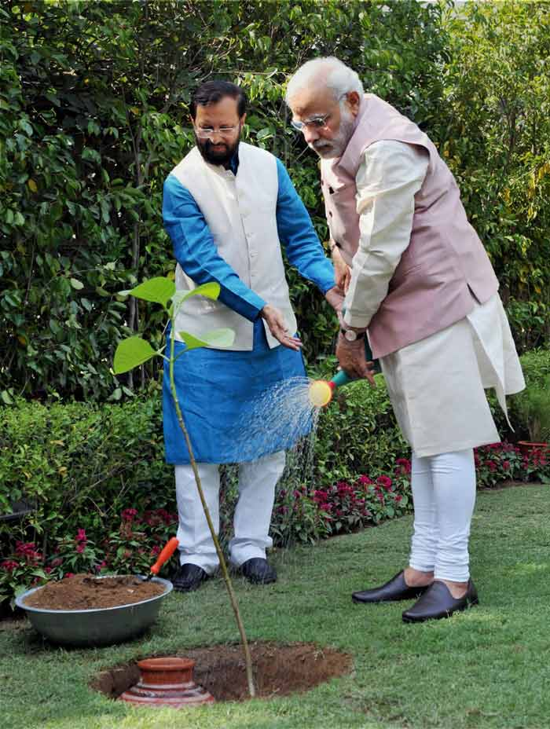
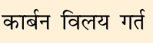
INDC Kasam #2
additional forest cover by 2030
Addl. carbon sink of 2.5-3 million tonnes of CO₂ equivalent

Slide 25
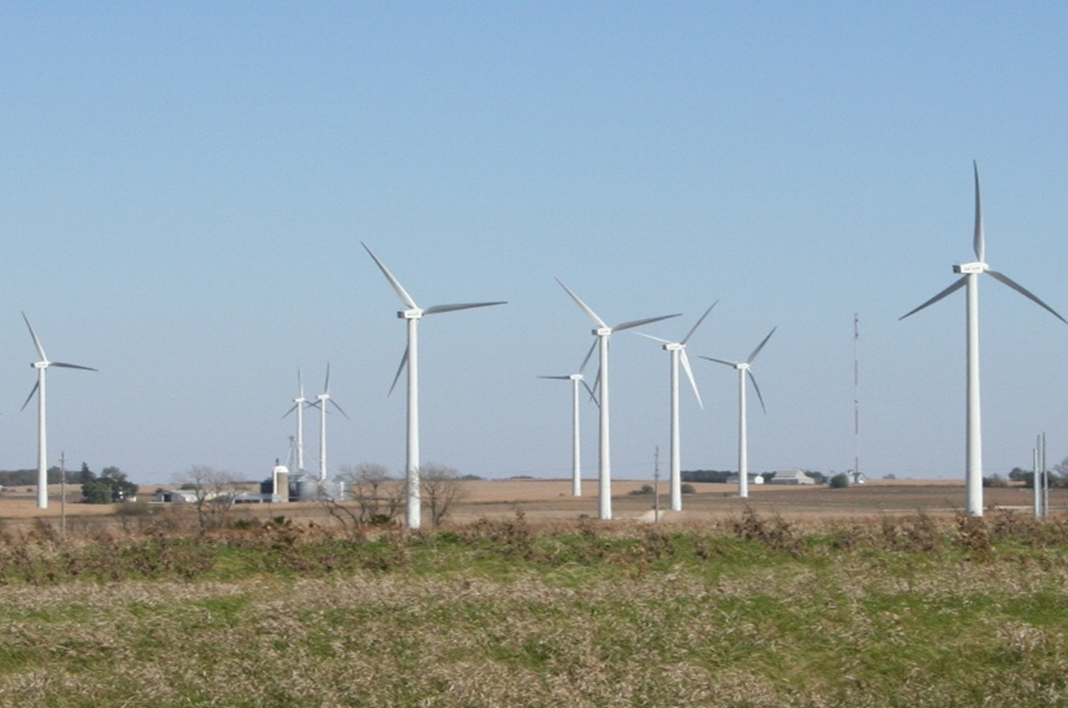
INDC Kasam #3 – by 2022: 175GW renewable
Solar
Biomass
Small Hydro
Wind
Target
Source
100
60
10
5
2030: 40% of cumulative installed capacity will be renewable.
Clean coal technology.

Slide 26
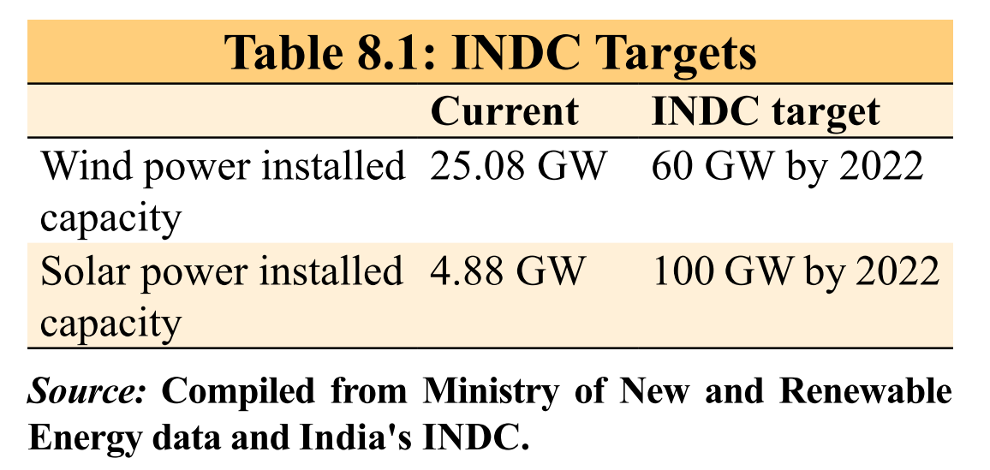

CRITICISM against India’s INDC
PARIS Summit
So far majority of funding came from budget.
INDC = $ 2.5 trillion required! How and where to get?
Too ambitious, ground process is dismal.
क्योकि हमको मज़ा नही आएगा
Notes:
In addition to mitigation-related activities, the INDC also incorporates adaptation-related activities.
Out of the eight National Missions on Climate Change in India, five focus on adaptation in sectors like agriculture, water and forestry
INDC also highlights India’s major initiatives taken for rural livelihood security and disaster
management.
However, the task is enormous as can be seen from a comparison on some actuals with the targets (Table 8.1).
Mobilizing finance is critical to achieving the ambitious targets set by India. Preliminary estimates suggest that at least US$ 2.5 trillion at 2014-15 prices will be required for meeting India’s climate change action under the INDC between now and 2030.
While the maximum share of the country’s current climate finance comes from budgetary sources, India is not relying solely on them and is experimenting with a careful mix of market mechanisms together with fiscal instruments and regulatory interventions. However, it needs to be emphasized that international finance is a critical enabler for the scaled up climate action plans.

Slide 27

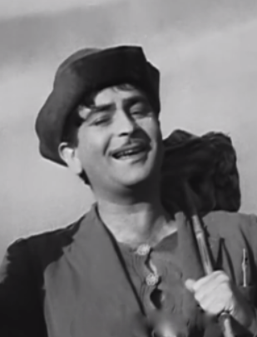
India INDC, yet we made ambitious commitments!
PARIS Summit
World: People with safe drinking water
15% of them in India
World: people without electricity
~25% of them in India
World: poor
30% of them in India
And hosted ISA!
Gave Rs.100 Cr!

Slide 28
India INDC, has all FIVE elements
PARIS Summit
Adaptation
Mitigation
Finance
Technology
capacity building
Total 6 cr. tonnes CO₂

Slide 29
BES165► PARIS SUMMIT 2015 & Clean Energy
Pre-industrial level
CBDR, Kuznet
INDC
Funding
Implement When?
Clean Energy-India

Slide 30
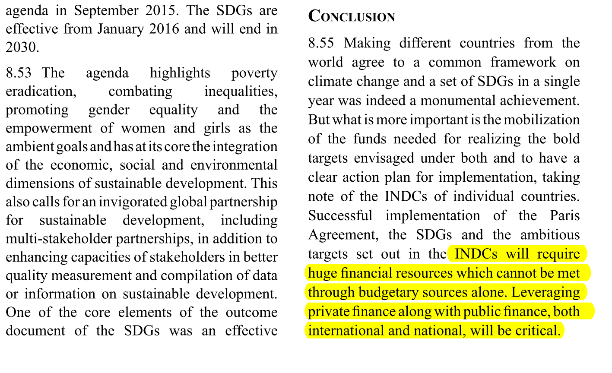
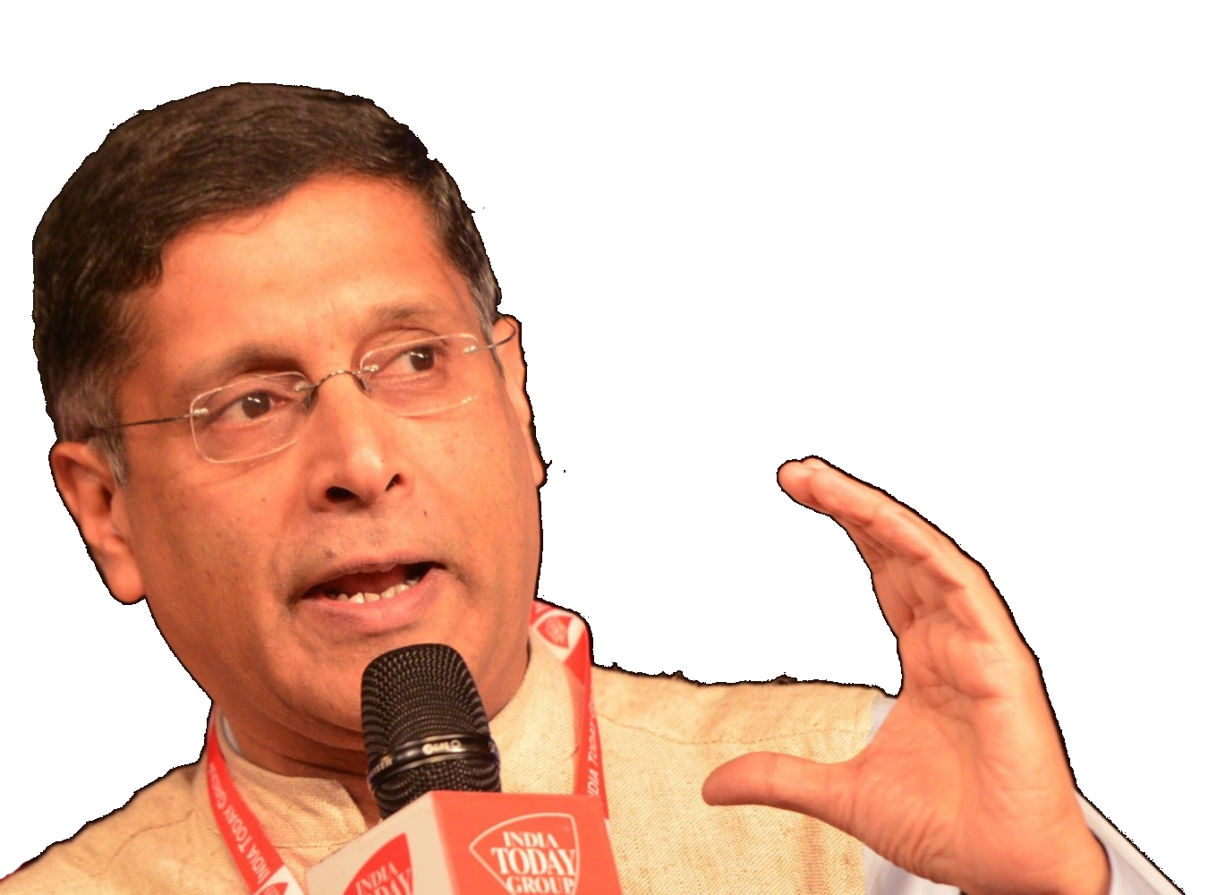
Survey-2015, v2c8

Slide 31

International Climate finance- Study “L8”
What’s new? World Bank’s informal “sustainable banking network”
20+ stock exchanges issued GREEN-ETF; UK- Green investment bank policy…
Carbon market
GEF
Kyoto Protocol
GCF
Songdo, SK
Washington
From 92’ Rio summit
India to use this money for INDC’s target of 40% cumulative renewable electricity
Notes:
To reduce the emissions intensity of its GDP by 33 to 35 per cent of the 2005 level by 2030.
To achieve about 40 per cent cumulative electric power installed capacity from non-fossil fuel- based energy resources by 2030 with the help of transfer of technology and low cost international finance including from the Green Climate Fund (GCF).
Box 8.2: Green Finance
Rio+20 document clearly states what green economy policies should result in and what they should not.
While there is no universal definition of green finance, it mostly refers to financial investments flowing towards sustainable development projects and initiatives that encourage the development of a more sustainable economy (Höhne et al. 2012).
. Green finance includes different elements like greening the banking system, the bond market and institutional investment.
China’s Green Credit Guidelines, the Climate Bonds Taxonomy of Green Bonds, the International Development Finance Club’s (IDFC) approach to reporting on green investment, the World Bank/International Finance Corporation’s (IFC) Sustainability Framework and the UK Green Investment Bank Policies.
e World Bank Group has set up an informal “Sustainable Banking Network” of banking regulators, led by developing countries, to promote sustainable lending practices. In 2015, green bonds issued by governments, banks, corporates and individual projects amounted to US$42 billion. Globally, more than 20 stock exchanges have issued guidelines on environmental disclosure, and many green indices and green ETFs (exchange-traded funds) have been developed
Financial Stability Board (FSB) has established a climate-related financial disclosures task force that is expected to complete its first stage of the work by end-March 2016.
Germany, the US and the UK have developed interest subsidy and guarantee programmes for green financing,
However, for developing countries like India, private finance will not readily be forthcoming and public finance both international and domestic needs to be used to leverage private finance.
Green development is also important for India though green finance is yet to pick up.
solar energy target, development of solar cities, setting up wind power projects, developing smart cities, providing infrastructure which is considered as a green activity and the sanitation drive under the ‘Clean India’ or ‘Swach Bharath Abhiyan’ are all activities needing green finance.
So far four banks have issued green bonds in India. Proceeds from these bonds are mostly used for funding renewable energy projects such as solar, wind and biomass projects and other infrastructure sectors, with infrastructure and energy efficiency being considered as green in their entirety
y. The Securities and Exchange Board of India (SEBI) has also recently approved the guidelines for green bonds.

Slide 32
Intl. climate funds: 3 types of
Mitigation
Adaptation
REDD
Reducing emissions from deforestation and forest degradation
Reduce GHG
Accept global warming will happen, take adaptive measures.
Notes:
t rackIng c lImate F Inance
m ultIlateral c lImate F unds
International climate funds can either be multilateral or bilateral depending on the participating countries.
Funds may further be classified according to their area of focus, namely
Currently, the Green Climate Fund (GCF) is the largest, with pledges amounting to US$10.2 billion. The second largest is the Clean Technology Fund (CTF) with pledges amounting to US$5.3 billion.
there is ambiguity about the role of the CTF in the climate finance architecture post-2020.
The GCF 8.35 The GCF was established as an operating entity of the financial mechanism of the UNFCCC in 2011 and is expected to be a major channel for climate finance from developed to developing countries.
The highest contribution of US$3 billion has been announced by the USA, followed by Japan (US$1.5 billion), the UK (US$1.2 billion), France (US$1.03 billion) and Germany (US$1.0 billion).
. Some countries including the USA are yet to sign the pledged amounts.
Global Environment Facility 8.36 The Global Environment Facility (GEF) was established as a pilot programme for environmental protection.
The current project cycle is GEF-6 over the years 2014-18.
In 1992, when the Biodiversity and Climate Change Conventions were adopted at Rio de
Janeiro, the GEF was adopted as a financial mechanism for helping developing countries meet their financing needs

Slide 33
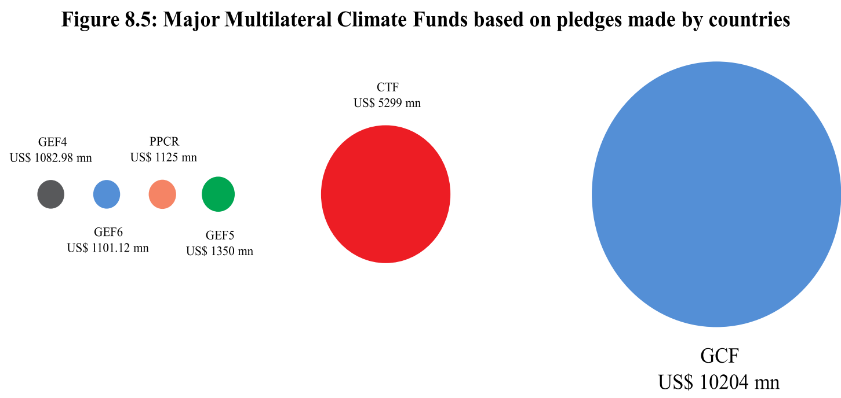
GCF pledge- USA>Jap>UK>Germany but <60% of pledge money received
GREEN
CLIMATE
FUND
CTF- clean tech. fund
2008: World Bank administers
3rd world& MIG
Focus: Mitigation
No clear agenda on how fits in post-2020?

Slide 34
CRITICISM Finance
PARIS Summit
Counted “promises” rather “actual disbursement”.
No clear definition of climate finance. Even SDM/MDG purpose finance fully counted.
“double” counting of loans given by Multi lateral banks, foreign assistance etc.
Committee to define “Climate Finance” @later stage.
Notes:
8.32 Policymakers around the world are alive to the compulsion of combating climate
Lack of a clear definition of climate finance has led to controversies in recent estimates of climate financ
The report seems to include the full value of multilateral development bank (MDB) loans as well as official development assistance (ODA), some private finance, export credits, etc. as climate finance, leading to double counting.
. Also it includes the promises, pledges and multi-year commitments and not actual disbursements as climate finance
Paris Agreement
is silent on the definition of climate financ
While the question of what counts as climate finance would be decided at a later stage by the Standing Committee on Finance under the UNFCCC,
while defining climate finance , i t i s also important to define what cannot be counted towards climate finance. Aid money meant for development purpose should not be counted as climate finance
. With reference to funds provided for multiple purposes, only the share provided solely for climate change should be included under climate financ
e. Also systems should be in place to check for double counting or treatment of ODA as climate finance.
. There is an even greater gap in tracking adaptation finance and segregating it from development funds as a whole; as a result, very often the entire amount allocated to a project is erroneously treated as adaptation finance.

Slide 35
CRITICISM Carbon Trading (L8)
PARIS Summit
Paris: Less focus on “Mitigation” (=GHG ▼)
Silent on future of Clean Development mech (CDM) and carbon credit.
Major nations pulling out of Kyoto (USA, Canada)
Carbon market down.
India has 2nd highest CDM projects after China
Notes:
Clean Development Mechanism (CDM), created multilaterally under the UNFCCC is one of the mitigation instruments under the Kyoto Protoco
Lack of mitigation ambition in the pre-2020 period has slowed its momentum.
major players pulling out of Kyoto Protocol has further suppressed the demand for certified emissions reduction (CER) credits.
At present, the CDM is facing its most severe crisis since it was set up a decade ago.
The CDM has witnessed a steady decline in the number of projects being registered since 2013 (Figure 8.6) owing to the crash in the price of CERs since 2012.
Given that pre-2020 mitigation ambition is limited, the demand for CERs is expected to remain subdued
Paris Agreement mentions voluntary cooperation among Parties through the use of internationally transferred mitigation outcomes.
It remains to be seen whether the Kyoto flexibility mechanisms would be continued beyond 2020 or what form the mechanism takes.
Till date, India has received US$516.6 million of GEF grant, of which US$324.69 million is for climate change mitigation projects while US$10 million is for climate change adaptation projects.
As on 4 January 2016, 1593 out of a total of 7685 projects registered by the CDM executive board are from India, which so far is the second highest in the world with China taking the lead with 3764 projects registered. Indian projects have been issued 191 million CERs, 13.27 per cent of the total number of CERs issued.
These projects are in the energy efficiency, fuel switching, industrial processes, municipal solid waste, renewable energy and forestry sectors and are spread across the country.
About 90-95 per cent of the CDM projects are being developed by the private sector,
facilitating investments of about R583,751 crore (US$ 87.77 billion)

Slide 36

National finance, funding against Climate change
Taxation
Budget 2016
NAPCC
Nehru
Coal Cess
PAT
Misc.
CAMPA
PSL
Funds
Green bonds
BES161
SELF Study- “L8”

Slide 37
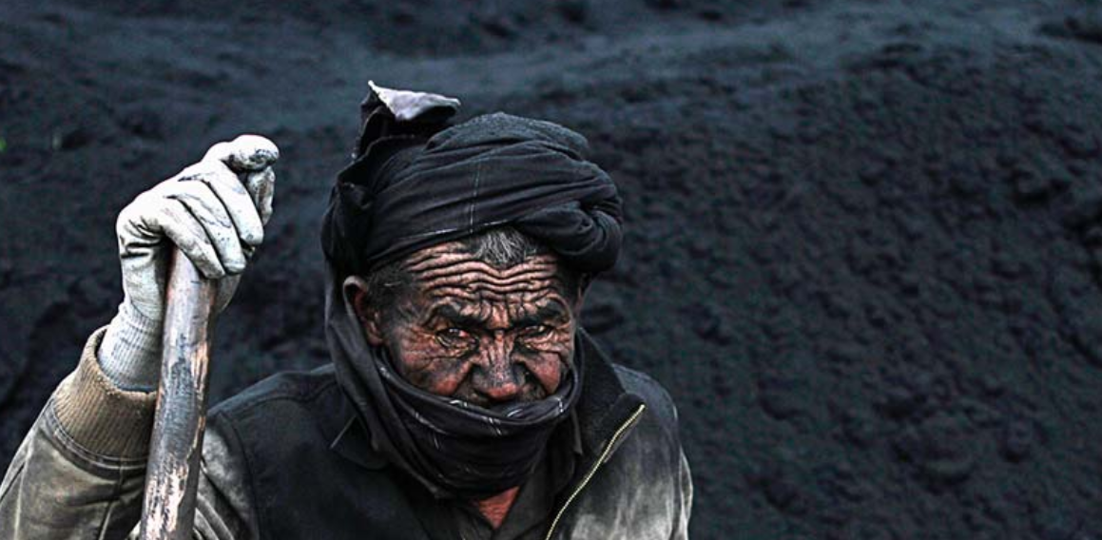
GREEN Taxation on Coal production
2010
Rs. 50/Tonne
2016
Rs. 400/Tonne
2015
Rs. 200/ Tonne
Rename: Clean Energy Environment Cess
MONEY GOES To National Clean Energy Fund (NCEF)
Notes:
Coal Cess and the National Clean Energy Fund
India is one of the few countries around the world to have a carbon tax in the form of a cess on coal.
India imposed such a cess but it has also been progressively increasing it
The coal cess which was fixed at R50.00 per tonne of coal since 22 June 2010 and increased to R100.00 per tonne of coal in Budget 2014-15, was further doubled to R 200.00 per tonne in the 2015-16 Budge
hich is supported by the cess on coal was created for the purposes of financing and promoting clean energy initiatives, funding research in the area of clean energy

Slide 38
NAFCC
National Adaptation Fund for Climate Change (NAFCC)
Rs. 350 cr till 2017
"Adaptation" measures for national and state plans
1st priority to esp. vulnerable.
NABARD implementing agency
External $$ not credited here.
Budget 2015

Slide 39
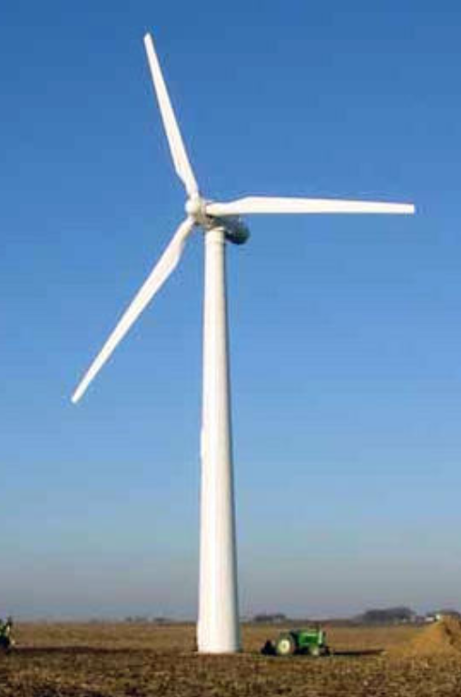
RPO under Electricity Act 2003
DISCOMs
Open access consumers (1MW)
Captive users (Coal/Natural gas)
Have to Generate certain % of electricity from renewable sources
Else buy Re.Energy Cert. from others
1 Cert = 1MW
Stalemate- RPO not purchased, Stiff penalty for backlog, appeals
HW: Compare-Contrast with PAT- ESCert? (“L8”)
Notes:
Renewable Purchase Obligation

Slide 40
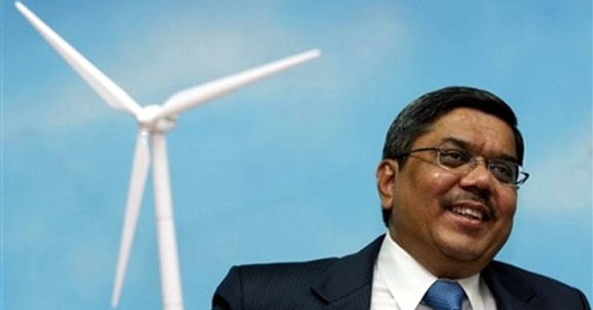
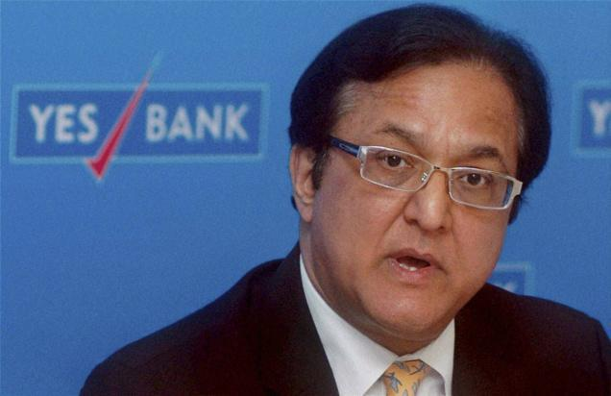


Green Bonds
12%
Green Bond 8%
@Mr. Tulsi Tanti your project risk high, so I can’t give you cheap loan for long tenure.
we want to start thermal/steel plant with clean coal tech. but they’re not giving $$ ☹

Slide 41
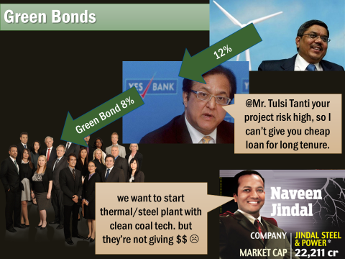

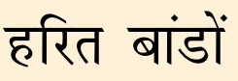
INDC = $ 2.5 trillion by 2030
Private investment mobilization difficult if green bond such face problems.
Notes:
60% thermal energy: Should fund “greening technology” rather than just solar / wind.
Banks overestimate risk
Tenure shorter, interest rate high.

Slide 42
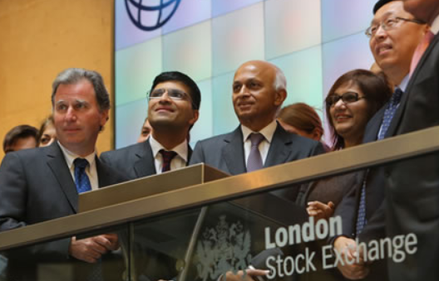
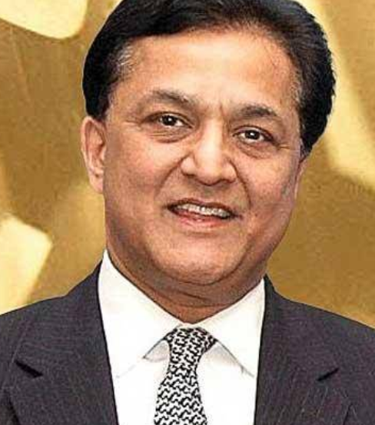


Green bonds: Yes, EXIM, IDBI, CLP
2015:
1st to launch green infra. Bonds, worth 1kcr.
2016- won award in UK
2016:
IFC+Yes Bank
1st Green “MASALA” bond @London stock exchange
2016, Jan: SEBI issued official guidelines
Notes:
Solar and wind projects

Slide 43
PARIS SUMMIT 2015
Pre-industrial level
CBDR, Kuznet
INDC
Funding
Implement When?
Clean Energy-India

Slide 44
When will it come into force?
TFA
Min. 55 parties (out of 195), Who contribute 55% of World-GHG
Paris
Ratified by 2/3rd members
Depository: Secretary Gen UN
Can withdraw after 3 years.
Notes:
it is under the aegis of the UNFCCC and will come into force only when at least 55 Parties to the Convention, accounting for at least an estimated 55 percent of total global greenhouse gas emissions, have deposited their instruments of ratification, acceptance, approval or accession.

Slide 45
Paris Summit: Signing vs. ratification
Step#1: Sign. Last date 21-04-17
Step #2: Ratify. NO DEADLINE
India: simply cabinet decision
USA: need assent of both houses.
EU: Each member-nation (28)
“Show” intention – India and many others did on 22nd April 2016 i.e. Earth Day
Notes:
22nd April 2016- Earth day, India “signed”, many others too- for symbolism.

Slide 46
Signing and ratification
PARIS Summit
Not signed- major oil producing states like Saudi Arabia, Iraq, Nigeria and Kazakhstan.
15 Ratified: Marshall Islands, Barbados, Fiji, Tuvalu, Mauritius, Somalia and Palestine = Total ~0.04 of GHG
***(as of Apr’2016 data)
Notes:
Clean Development Mechanism (CDM), created multilaterally under the UNFCCC is one of the mitigation instruments under the Kyoto Protoco
Lack of mitigation ambition in the pre-2020 period has slowed its momentum.
major players pulling out of Kyoto Protocol has further suppressed the demand for certified emissions reduction (CER) credits.
At present, the CDM is facing its most severe crisis since it was set up a decade ago.
The CDM has witnessed a steady decline in the number of projects being registered since 2013 (Figure 8.6) owing to the crash in the price of CERs since 2012.
Given that pre-2020 mitigation ambition is limited, the demand for CERs is expected to remain subdued
Paris Agreement mentions voluntary cooperation among Parties through the use of internationally transferred mitigation outcomes.
It remains to be seen whether the Kyoto flexibility mechanisms would be continued beyond 2020 or what form the mechanism takes.
Till date, India has received US$516.6 million of GEF grant, of which US$324.69 million is for climate change mitigation projects while US$10 million is for climate change adaptation projects.
As on 4 January 2016, 1593 out of a total of 7685 projects registered by the CDM executive board are from India, which so far is the second highest in the world with China taking the lead with 3764 projects registered. Indian projects have been issued 191 million CERs, 13.27 per cent of the total number of CERs issued.
These projects are in the energy efficiency, fuel switching, industrial processes, municipal solid waste, renewable energy and forestry sectors and are spread across the country.
About 90-95 per cent of the CDM projects are being developed by the private sector,
facilitating investments of about R583,751 crore (US$ 87.77 billion)

Slide 47

Voice?
PARIS Summit
1 member 1 vote
EU=?
Regional economic integration org. = votes = total member, but individual nations can’t vote.
EU = 28 27 Votes? (Brexit Art 50- two years to divorce)

Slide 48
UPSC CAPF-2016 (BES165)
79) Paris agreement of UNFCCC COP-21, will be effective when it’s signed by
51 parties accounting for min. 51% of global GHG
51 parties accounting for min. 55% of global GHG
55 parties accounting for min. 55% of global GHG
75 parties accounting for min. 51% of global GHG
It should be “Ratified”

Slide 49
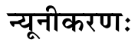
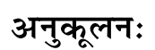
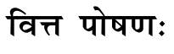
Paris Summit: Positives
KYOTO
1st world
Top-down
PARIS
Requires all to reduce GHG
INDC
=umbrella with common cause
Mitigation centric
Mitigation, Adaptation, Finance…
Notes:
This universal agreement will succeed the Kyoto Protocol
rather than trying to repeat a top-down approach advocated by the Kyoto Protocol, giving each country an emission reduction target.
Placing emphasis on concepts like climate justice and sustainable lifestyles, the Paris Agreement for the first time brings together all nations for a common cause under the UNFCCC.
Agreement is not mitigation-centric and includes other important elements such as adaptation, loss and damage, finance, technology development and transfer, capacity building and transparency of action and support.

Slide 50
PARIS SUMMIT 2015
Pre-industrial level
CBDR, Kuznet
INDC
Funding
Implement When?
Clean Energy-India

Slide 51

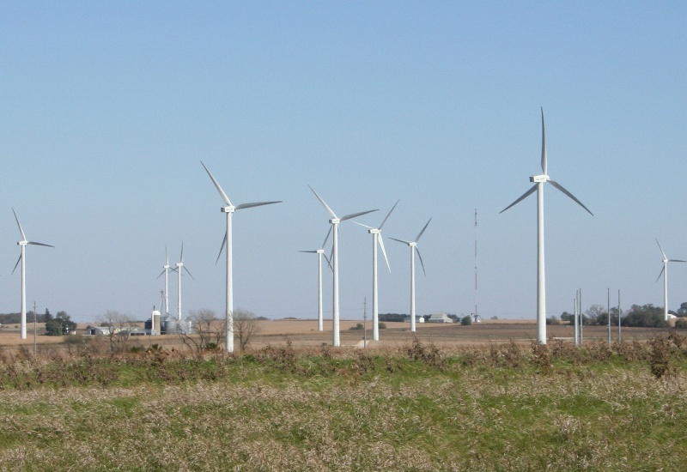

MAY 2016
Solar
Wind
Biomass
Small Hydro

Slide 52
INDC► Renewable energy Targets
Total Target 175 GW 😯
40 GW from Rooftop solar plants.
School, PHCs can give 6% of that
Need 6 Lakh Cr. Investment
10 Lakh full time jobs- install, op, maintenance, engineering
SuryaMitra Skill Trainig for 50k youth ==under National Inst. Of Solar energy.
~40 GW
Hardly 22% of 2022’s Target 😬
MNRE Rural electrification programme
1.8 lakh + jobs
Mostly rural, peri-urban areas
DESC.

Slide 53
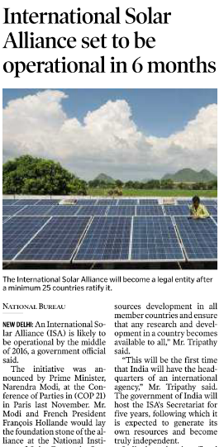
Intl. Solar Alliance
Launched on sidelines of Paris Summit.
121 Countries with land between Capricorn and cancer (fully / partially)
Having 300 days or more sunlight
Get $3 trill. By 2030
India to host Secretariat in Gurugram for 5 years, already gave 100 crores.
Notes:
launched at UNFCCC’s Paris-Summt
mobilise 1000 billion dollars investment by 2030
121 solar rich countries

Slide 54
Jawaharlal Nehru National solar Mission
category
GRID Power including rooftop solar plants
Off Grid solar applications
phase I:2010-2013
Phase II: 2013 to 2017
solar collectors
Phase III: 2017 to 2022
Ascending Order
Solar energy Corporation of India under MNRE
Incl. Solar water heater, thermal refrigerator. 2 cr. Solar lanterns
Original Target 20GW
Increased to 100 GW by Modi
Descending order
Solar city by MNRE
Reduced conventional energy demand by 10% in next five years
>50 cities approved ; upto Rs.50 lakh given to ULB
Notes:
Solar lanterns can help a reduction in kerosene consumption.

Slide 55
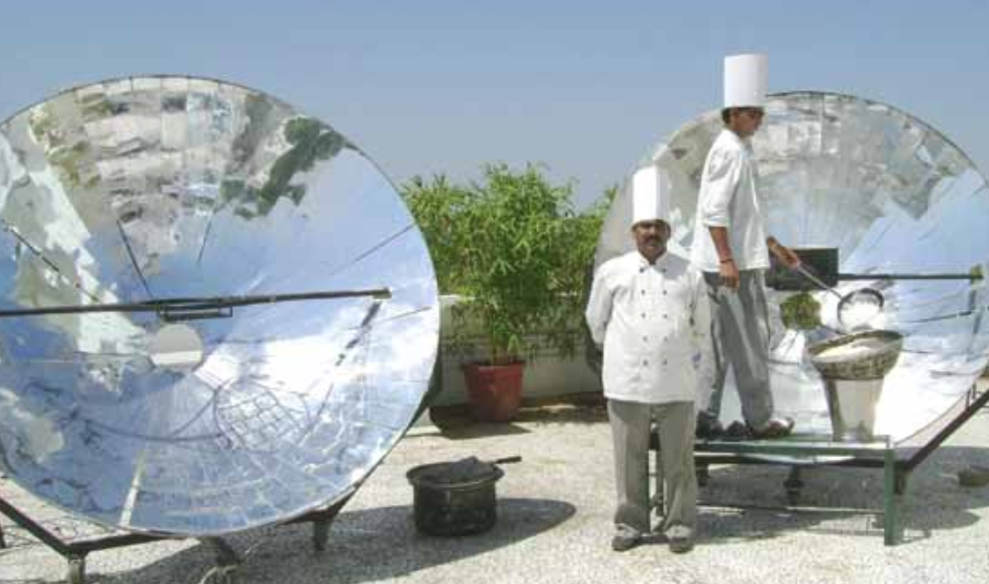
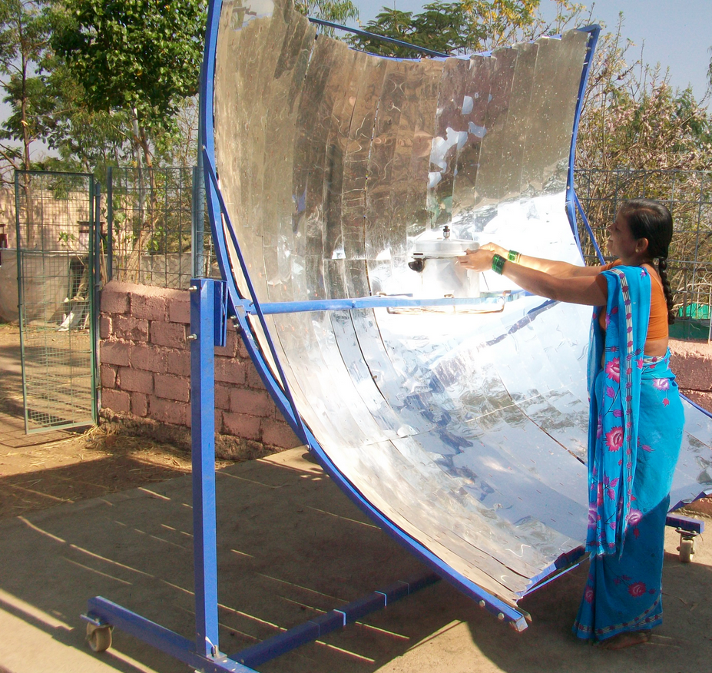
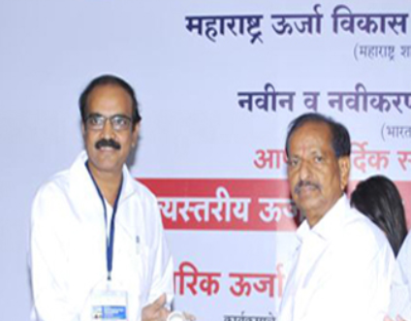
GS3: Solar Cooker
Prof. Ajay Chandak
Solar concentrator
SK-23 cooker, but portability difficult.
In multiple size, dimensions for household to university scale 15..40
Smoke, heat, sparetime, better taste
Prince-40: Portable, Knockdown DIY-assembly kit
Promoters and Researchers In Non-Conventional Energy (PRINCE)- NGO
GSM3: Achievements of Indians in science & technology; indigenization of technology and developing new technology.

Slide 56
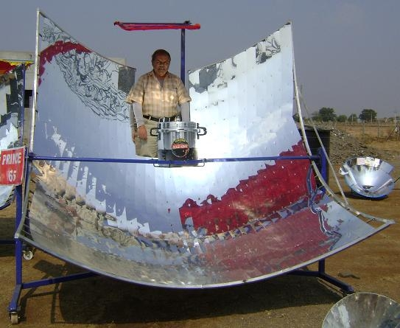
Applications of PRINCE Solar Cooker
Sterilization
As Autoclave for sterilization of surgical tools
In medical colleges, hospitals, PHC
Electricity shortage ☹
12 lakh MDM-schools, most of them use firewood ☹
Cooking
Army, Hostels, community kitchen, MDM,
60 minutes to cook 5kg rice, 5kg potato ….
Notes:
Small scale version of centralized electricity system
Generate, distribute and regulate the flow of electricity to local consumers
helping community level electrification
Low carbon footprint, integration of renewable energy sources.

Slide 57
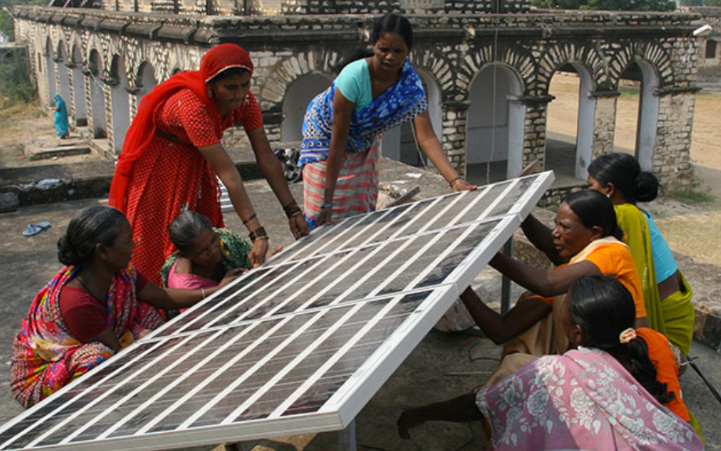
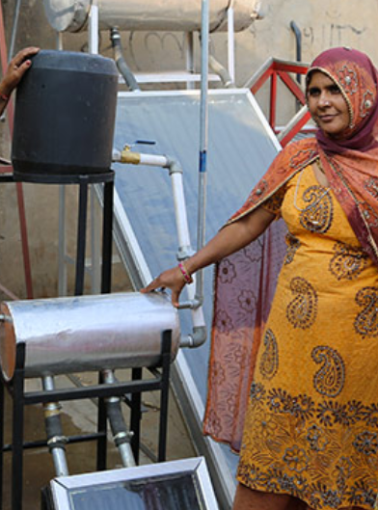

Barefoot college, Rajasthan: Women trained to install, repair solar equipments
GS2: SHG, NGO role in Development

Slide 58

Solar energy: applications of
Solar dryer
Food processing industry
solar milking machines
potato chips
Dairy industry
solar electric fences
to keep away wild animals from farmland
Solar desalination plants
in coastal areas
Solar E-Rickshaws
Can help in connectivity for rurbanization and PM Gram Sadak Yojana.
Reduce diesel consumption
Solar tractor, Solar Water pump
Solar Lanterns- substandard products- hence Solar Energy corp. Intervened.
Reduce Kerosene consumption- fire hazards
Reduce firewood consumption
85% of Rural India depends on solid fuels for cooking- Census 2011

Slide 59
MAY 2016
Solar
Wind
Biomass
Small Hydro

Slide 60

Wind turbine: Types of
Stall regulated
Pitch regulated
Fixed rotor blades
Blades change angle depending on wind speed

Slide 61
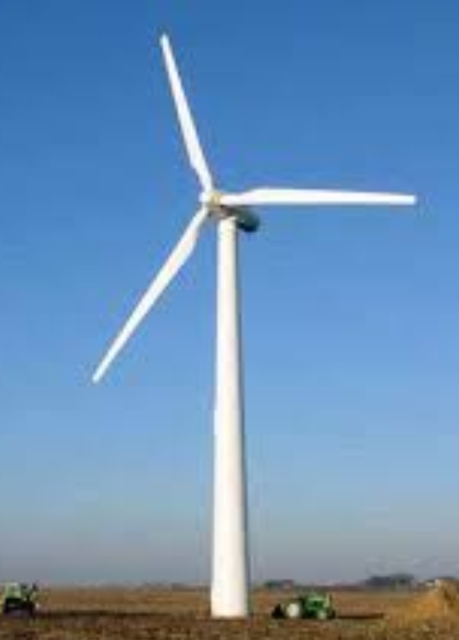
Wind Energy
Negatives
Bird kill; Noise pollution; TV reception problem
Strong, dependable wind
“intermittent”: not produce energy all the time. You need backup supply from other source.
Voltage fluctuates, difficult to connect with grid.
Enforcement of Power purchase Agreement between buyer and producer
>500kw turbines- have to import.

Slide 62
Wind Energy
Negatives
Blades get damaged from high wind, lightning.
Rotating parts high from ground, difficult to repair
Not helping Rurbanization: farmer can either sell/lease land, or work as unskilled labour in beginning. Youth shd be able to come back, but proper training / jobs not generated.

Slide 63
renewable Energy
Accelerated depreciation
Custom duty concession
Generation based incentive- beyond certain capacity.
+ RBI also included renewable energy within PSL targets for SCB: BES161/P9
Fiscal policy
Notes:
Preferential tariff: Tamilnadu, Rajasthan

Slide 64
Offshore Wind Energy Policy 2015
Policy
Within 200 nautical miles of exclusive economic zone (EEZ)
Taxation: accelerated depreciation benefits for wind power projects
Setup projects and R&D; Help wind turbine mfg. industry.

Slide 65
MAY 2016
Solar
Wind
Biomass
Small Hydro

Slide 66
Biomass – how to derive energy?
Anaerobic Digestion
Refuse Derived Fuel
Gasifiers
Biogas (45-65% CH₃)
Slurry/Manure: both NPK & Micronutrient
Partial oxidation
drying
Palletization
Syngas / solid char/ bio-oil
Electricity, ceramic industry
Cheaper <LPG
briquettes
Acidogenic/ Methogenic bacteria
For non-biodegradable material / waste with less moisture

Slide 67
Biomass ► Anaerobic Digestion ► Biogas
Natural Anaerobic digestion:
Swamp, water logged bodies, deep water bodies, Paddy fields
Bovine digestive system
Biogas
CH₃: 70%
CO₂
H₂O Vapor
H₂S
Bio-methane
CH₃: >90%
Bio-CNG
Bottled @200 bar pressure
Decreasing
India: largest cattle popu.
>2 lakh CNG cars can be run
Delhi alone >8lakh CNG cars ☹

Slide 68
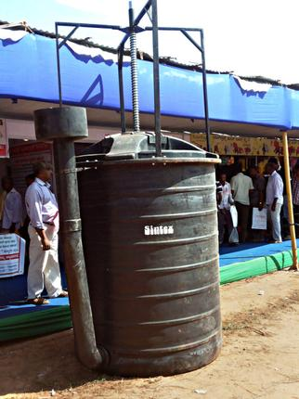
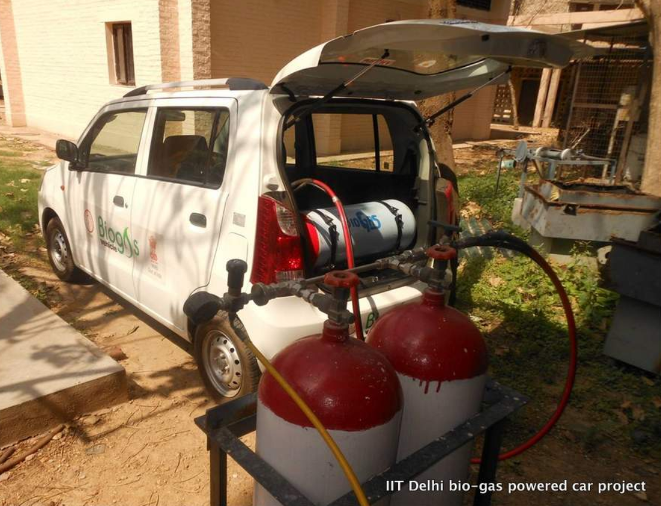
IIT Delhi: biogas inventions
Compact Biogas Digester
Size of ~refrigerator
kitchenwaste- 10% to LPG bill
40,000 km tested, emits << Petrol/Diesel
Existing CNG cars can use.
GSM3: Achievements of Indians in science & technology; indigenization of technology and developing new technology.

Slide 69
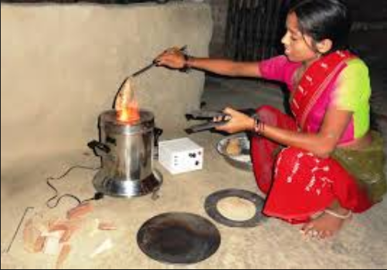

National Biomass Cookstoves / Unnat Chulha
by MNRE, 2009
Market mech- ~50% subsidy
But, Regional cos. ► After sales service: Poor
No ITI course unlike solar energy.
GSM2: Scheme design and implementation issues
Notes:
Freelance repairmen not available because se of ITI issue.

Slide 70
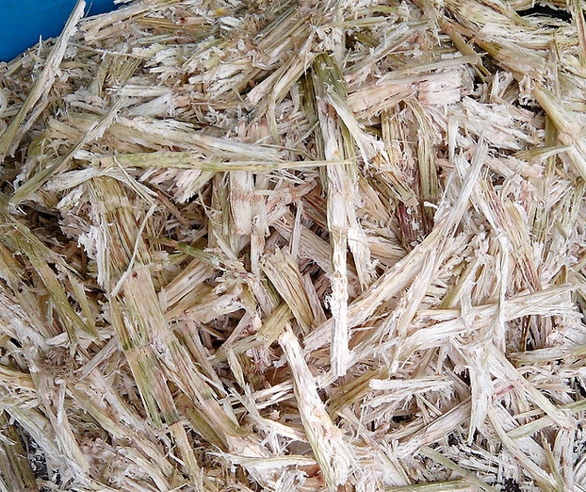
Bagasse Cogeneration
Single Fuel ► two forms of energy
Electricity
Customers
Heat (Steam Turbine)
Sugar mill
Bagasse Fibrous matter leftover after sugar crashing

Slide 71
Kurukshetra, May’16, p34
(A) Biomass based fuels don’t add CO₂ in atmosphere
(R) Biomass absorbs same amount of Carbon in growing, as it releases, when consumed as fuel
Both correct, R explains A.

Slide 72
MAY 2016
Solar
Wind
Biomass
Small Hydro
BIOFUEL

Slide 73
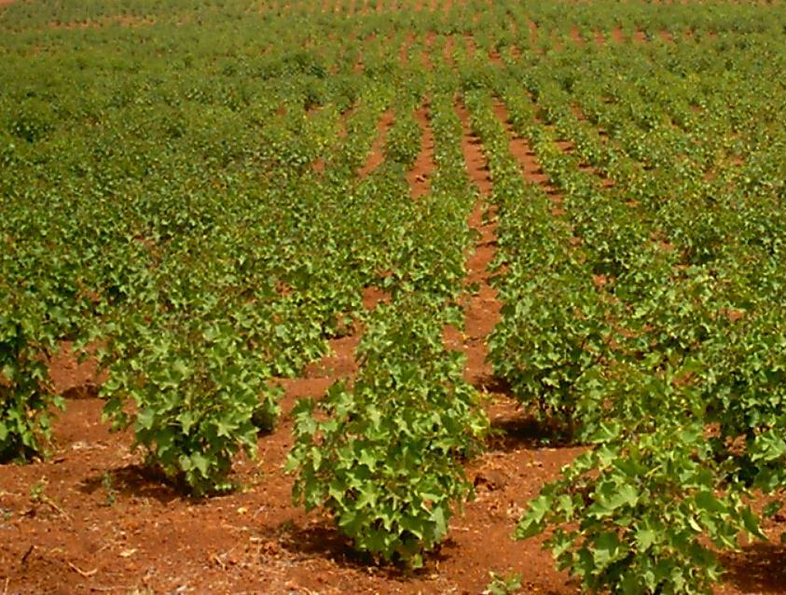
Biofuel
Meaning
Liquid or gaseous fuel
Examples
Methanol, ethanol, biodiesel
Produced from biomass
Gas: hydrogen and methane
Fischer-Tropsch diesel

Slide 74
Biofuel: Source
1st Gen
Sugar, starch walla Edible crops
2nd Gen
3rd Gen
Algae hydrogen fuel, Oilgae
Non-edible “Ligno-Cellulosic” material
Jetropha, Mahua, Neem, Castor, Pongamia (Karanj), Sweet Sorghum
Food security ☹
World Highest: Rapeseed oil, sunflower oil, Soybean, Palm oil

Slide 75

Biofuel: How it’s made?
Bio-chemical
Pyrolysis: Long Carbon Chain fuel- diesel, aviation fuel
Thermo-Chemical
Microbes
Cellulose ► Sugar (glucose, Xylose)
Fermentation► Ethanol
Short Carbon Chain fuel
Gasification : Syngas (CO+H2)
India Target: 20% Blending Bio-ethanol, Bio-Diesel by 2017

Slide 76

Jatropha
Euphorbiaceae
Origin S.America
100+ species but only J.Curcas used
Catalyst + high temp + high pressure
If not removed, it’ll clog fuel filter
No Sulfur
5% blending in Railway diesel
Notes:
Originally from South America and Africa
Family Euphorbiaceae.
Greek: Jatros = Doctor, Jatropha = nutrition.
Hindi: Bagh Eranda, Jangli Eranda, Safed Eranda
Gujarati | Punjab = Jamal Gota.
Purgative and toxic.No animals eat it.
Can grow in wasteland, arid areas. Can withstand frost and drought.
Jatropha seed► oil ► Plant fat ►Biodiesel.

Slide 77
MAY 2016
Solar
Wind
Biomass
Small Hydro

Slide 78

Small hydro- total est. Potential 20,000 MW
Class | Capacity (kw)
Micro | Upto 100
Mini | Upto 2000
Small | Upto 25000
Large | >25MW
MNRE upto
20 cr. Subsidy
Union Power Ministry
Notes:
Min. Of new and renewable energy.

Slide 79

Small Hydro
Positive
Made on run of the river, no dam required
No deforestation, resettlement or rehabilitation
Works in remote-isolate area, even on irrigation canals
Long life, GHG down

Slide 80

Small Hydro
Negative
Hydro-mapping, rainfall/flood data not properly done, except few large rivers.
Natural calamities
Remote area- logistics, weather esp. Hill states
Resistance by locals; Union vs State- clearance issues.
RPO sale low; Rich /deficient states buying low.

Slide 81

GS3: Modified Hydro electric turbine
By Karnataka farmer G.K.Ratnakar
Direct AC power generate
Min. Noise, low maintenance
Water not exhausted, agri use
GSM3: Achievements of Indians in science & technology; indigenization of technology and developing new technology.

Slide 82


RE-Invest started since 2015, @Delhi
Billion Dollar investment target
In five years, MNRE to coordinate
Notes:
Perform Achieve and Trade (PAT) scheme under the National Mission on Enhanced Energy Efficiency was introduced as an instrument for reducing specific energy consumption in energy-intensive industries with a market-based mechanism that allowed the trading of ESCerts (energy saving certificate)
Currently, scrutiny of performance assessment documents by state designated agencies and by the Bureau of Energy Efficiency (BEE) is under process
Progress on the Renewable Energy Front in India
The First Renewable Energy Global Investment Promotion Meet and Expo (RE-INVEST) were organized in February 2015
RE-INVEST series of conference expos is to showcase India’s renewable energy potential and the government's efforts to develop and scale up the country’s installed renewable energy capacity

Slide 83
BES165► PARIS SUMMIT 2015 & Clean Energy
Pre-industrial level
CBDR, Kuznet
INDC
Funding
Implement When?
Clean Energy-India

Slide 84
BES165: Infrastructure
Nuke Energy NSG, HELP-2016
Postal, Telecom, Mass.Comm (YB)
Kelkar-PPP
Rail Budget CAP-2016
Urban Infra-Bills.
Paris Summit Clean Energy

